Slide 1
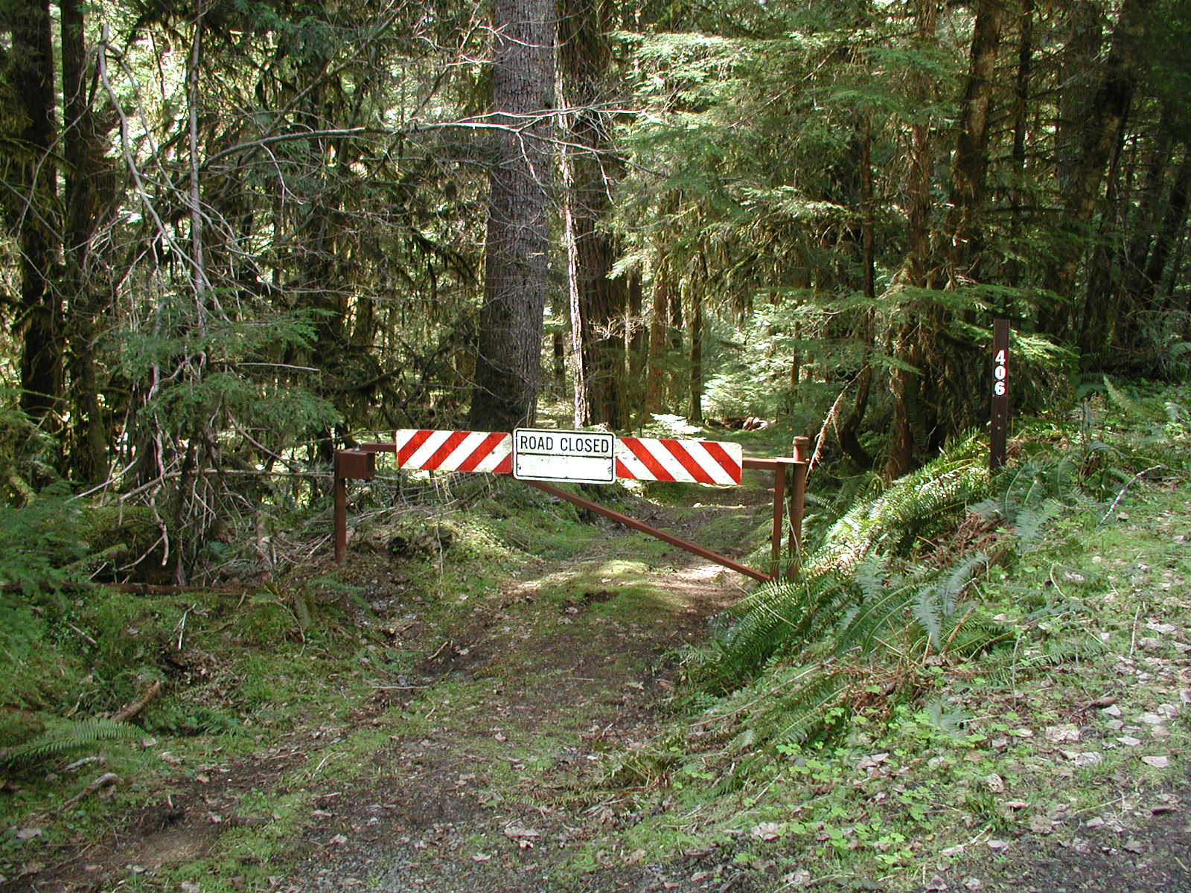
SOIL ORGANIC MATTER:
Can the LTER network be leveraged to inform science and policy?

Slide 2
The world is changing: why focus on soil organic matter?
SOM is a major component of the global C cycle, containing more C than plant biomass and the atmosphere combined
The C flux between soils and the atmosphere is large, with soil respiration about 10 times the C flux due to fossil fuel combustion
Interactions among the biological, chemical, and physical processes regulating SOM accumulation, stabilization, and turnover are poorly understood

Slide 3
What will change:
Temperature
Precipitation
Floods
Drought
Seasonality
Land-use, forest harvest, direct effects on litter production

Slide 4
What controls soil C stabilization and destabilization?
temperature,
vegetation,
mineralogy,
management?
Plant detrital inputs?

Slide 5
Detrital Input and Removal Treatments
(DIRT)
Central Goal: to assess how rates and sources of plant litter inputs control the long-term stability, accumulation, and chemical nature of soil organic matter in forested ecosystems

Slide 6
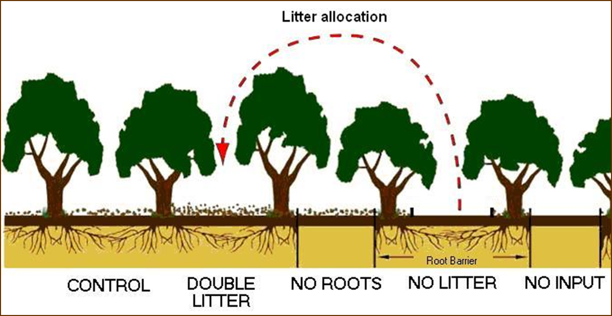
DIRT Treatments
Organic matter inputs are altered through additions of aboveground litter or removals of aboveground litter (via screens) and roots (via root barriers)
Organic matter inputs are altered through additions of aboveground litter or removals of aboveground litter (via screens) and roots (via root barriers)
Organic matter inputs are altered through additions of aboveground litter or removals of aboveground litter (via screens) and roots (via root barriers)

Slide 7
LTER and ILTER
DIRT Sites
Wisconsin
Harvard Forest
H.J.Andrews
Bousson
Síkfökút
Michigan
Santa Rita
Notes:
1

Slide 8
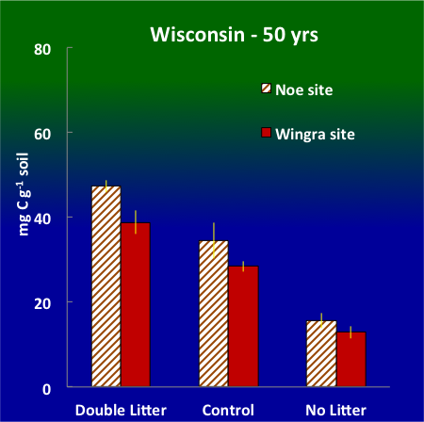
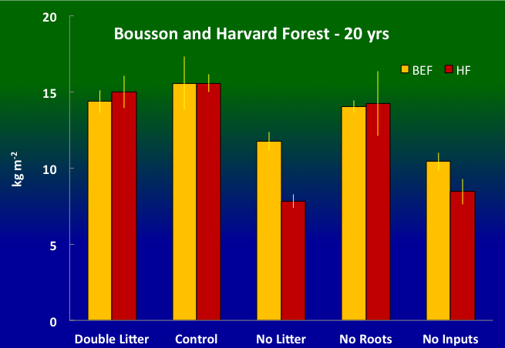
How long does it take for soil carbon to increase?

Slide 9
H.J. Andrews DIRT, 10 years

Slide 10
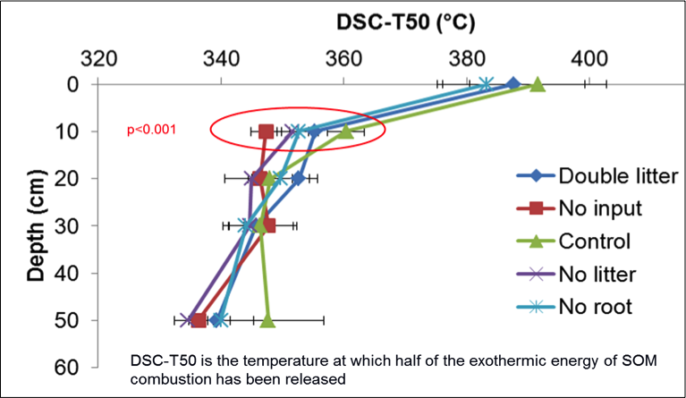

Slide 11
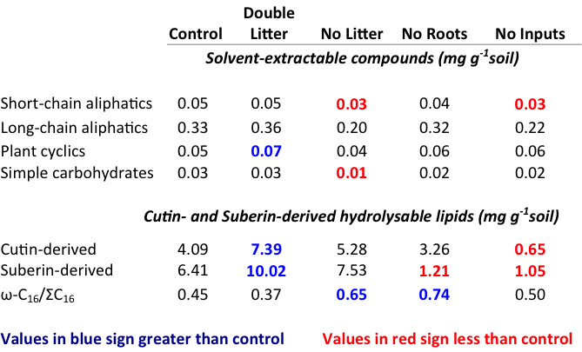

Slide 12
High-elevation (800-1100m), 15-22 ha headwater basins
WS08 (control), WS06 (clearcut, burned 1974),
WS07 (shelterwood 1974, overstory removed 1984
Low-elevation (450-700m), 9-10 ha headwater basins
WS09 (control), WS106 (clearcut, not burned 1975),
Mid-elevation (450-1000m), 60-100 ha headwater basins
WS02 (control), WS10 (clearcut, burned 1962-66)
Low to high-elevation (450-1600m), 600-6200 basins
MACK (old growth), LOOKOUT (25% clearcut 1948-70),

Slide 13
Questions of interest:
What contributes to stable SOM – root inputs or shoot inputs?
What is stable SOM?
What is the role of land-use change (CWD too) on SOM stocks and chemistry?
Does priming by root activity influence either stable or labile SOM?
How does microbial processing and activity affect SOM stabilization? Role of fungal to bacteria? Mycco? Foodweb?
How do differences in soil texture and mineralogy affect the balance between SOM stabilization and destabilization? (cross-site)
When will soils saturate – or will they?
Role of vegetation change? Temperature change? Climate change?

Slide 14
If not common experiments what about common measurements?
Considerations:
Sample to what depth?
Bulk density?
Rock volume?
Sample by depth or horizon?
Total C and N or density fractions – or --- ?
Problems with thatch in grassland plots?

Slide 15
DIRT protocol for grasslands
We have generally replicated all treatments 3 times, and have found that to be a minimum number of replicates – 5 is generally preferable.

Slide 16
DIRT protocol for grasslands
We have generally replicated all treatments 3 times, and have found that to be a minimum number of replicates – 5 is generally preferable.
TREATMENTS
UNMANIPULATED CONTROL
CONTROL vegetation is cut at the end of the growing season and spread evenly over the surface of the plot.
NO AG LITTER vegetation is cut at the end of the growing season and is removed, weighed, and saved. Grasses are cut so as not to harm roots or regrowth
NO ROOTS no plant growth is allowed within the plots; frequent clipping and herbicide is used sparingly as vegetative growth demands. Litter from NO LITTER plots is combined and mixed, evenly divided among NO ROOTS plots, and spread evenly over the surface of each plot.
NO INPUTS no plant growth is allowed within the plots; herbicide is used sparingly as vegetative growth demands.
DOUBLE LITTER vegetation is cut at the end of the growing season and spread evenly over the surface of the plot as for the CONTROL treatments. The same mass of litter that was added to NO ROOTS plots is harvested from off-site and added to each plot.
Note: all treatments can be crossed with a fertilization treatment

Slide 17
Questions of interest:
What contributes to stable SOM – root inputs or shoot inputs?
What is stable SOM?
What is the role of land-use change (CWD too) on SOM stocks and chemistry?
Does priming by root activity influence either stable or labile SOM?
How does microbial processing and activity affect SOM stabilization?
How do differences in soil texture and mineralogy affect the balance between SOM stabilization and destabilization? (cross-site)

Slide 19
total soil respiration
371 (100%)
618 (100%)
648 (100%)
decomposition
litterfall
V
E
G
E
T
A
T
I
O
N
above-
ground
S
O
I
L
O
M
new
above-ground
litter
HF 138
11%
BOU 183
HJA 145
7%
10%
old
above-ground
litter
26%
below-
ground
23%
15%
root litter
below-ground
litter
30%
56%
52%
root respiration
33%
14%
23%

